Slide 1
JSHint - A Javascript static Analysis Tool
Guangwei(Joe) Qiao
Software Engineer

Slide 2
Agenda
1
JSHint Overview
2
JSHint Usage
3
How to Integrate JSHint with Mave
4
How to Integrate JSHint with Jenkins
Q & A
5

Slide 3
Main Factors for High Code Quality
Unit Test
Code Coverage
Code Static Analysis

Slide 4
JSHint Overview
Community driven and open source in github.
Detect errors and potential problems in javascript code.
Flexible and configurable.
Provide amazing plugins for Text Editors and IDEs.
Notes:
JSHint is a community-driven tool to detect errors and potential problems in Javascript code. It is very flexible so you can easily adjust it to your particular coding guidelines and the environment you expect your code to execute in.

Slide 5
1
JSHint Overview
2
JSHint Usage
3
How to Integrate JSHint with Mave
4
How to Integrate JSHint with Jenkins
Q & A
5
Notes:
This is a sample Agenda/Preview slide. This slide is ideal for setting the scene at the beginning of your presentation by providing a big picture overview of what you plan to cover.
To Change Titles in Shapes (i.e.: “Text here”):
Select text. (Optional: Press Delete.) Begin typing desired text.
To Change Font Color/Size:
Select text, right-click and adjust the font setting on the Mini toolbar. Select desired attributes to change: font, size, boldness, color, etc. Note: many of the same commands can also be accessed from the Font group of the Home tab.
To Change a Shape’s Fill Color:
Select the desired object by clicking once on its edge. On the Home tab, click the Shape Fill button within the Drawing group to select a theme color from the Symantec color palette.
To Delete a Shape:
Select the desired object by clicking once on its edge. Press the Delete key on your keyboard.
To Copy a Text Box or Shape:
Select the text box or shape. Note: Make sure to select the entire object, not just the text, by clicking the edge of the text box or shape.
Type Ctrl C (copy), click outside object, then type Ctrl V (paste) to place the object. Click and drag the pasted object to desired location.

Slide 6
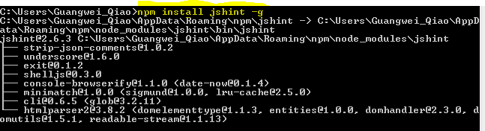

JSHint Base Usuage
Install JSHint as a Node program.
Notes:
The easiest way to use JSHint is to install it as a Node program. To do so, simply run the following command in your terminal npm install jshint –g
After you've done that you should be able to use the jshint program. The simplest use case would be linting a single file or all JavaScript files in a directory.

Slide 7
JSHint Configuration
Using Configuration File
Specify configuration file manually via the --config flag.
Put you config into your projects package.json file under jshintconfig property.(For Node project)
Use a special file .jshintrc (recommended)
Inline Configuration
Notes:
JSHint comes with a default set of warnings but it was designed to be very configurable. You have three methods to configure your copy of JSHint
jshint undefined.js –config jshintrc
The third method is recommended, using .jshintrc, JSHint will start looking for this file in the same folder as the files to be linted. If not found, it will move one level up the directory tree all the way up to the file system root. You can make use of this character, place your file into the project root directory and, as long as you run JSHint from anywhere within your project directory tree, the same configuration file will be used.

Slide 8
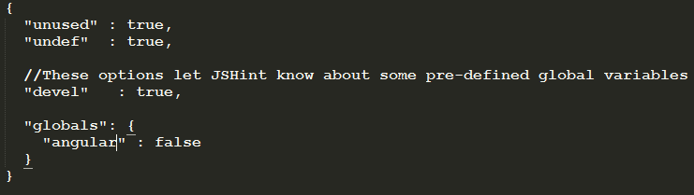
JSHint Configuration (contd)
Configuration file is a simple JSON file that specifies which JSHint options to turn on or off. For example, the following file will enable warnings about undefined and unused variables and tell JSHint about a global variable named “angular” as read-only.

Slide 9
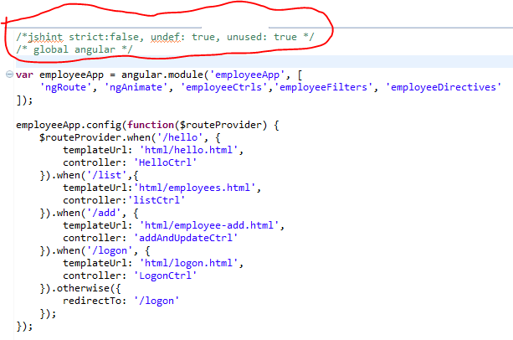
JSHint Configuration (contd)
Inline configuration in javascript file
Notes:
In addition to using configuration files you can configure JSHint from within your files using special comments. These comments start either with jshint or global and are followed by a comma-separated list of values.

Slide 10
JSHint Directives
Jshint - A directive for setting JSHint-compatible JSLint options.
/* jslint vars: true */
global - A directive for telling JSHint about global variables that are defined elsewhere. If value is false (default), JSHint will consider that variable as read-only
/* global MY_LIB: false */
/* global -BAD_LIB */ --blacklist certain global variables
Exported - A directive for telling JSHint about global variables that are defined in the current file but used elsewhere.
/* exported EXPORTED_LIB */
Ignore - A directive for telling JSHint to ignore a block of code.
/* jshint ignore:start */
// Code here will be ignored by JSHint.
/* jshint ignore:end */
Notes:
Here's a list of configuration directives supported by JSHint.
You can also blacklist certain global variables to make sure they are not used anywhere in the current file.

Slide 11
JSHint Options - define your own javascript code standard
Enforcing Options
Relaxing Options
Environments
Notes:
Enforcing Options :When set to true, these options will make JSHint produce more warnings about your code.
Relaxing Options: When set to true, these options will make JSHint produce fewer warnings about your code.
Environments: These options let JSHint know about some pre-defined global variables.

Slide 12
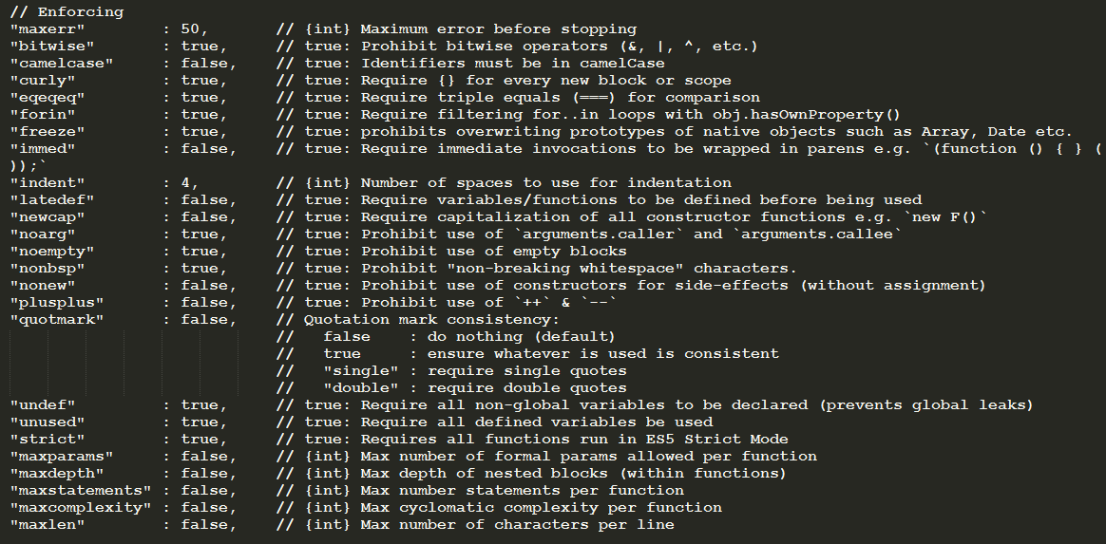
JSHint Options (contd) -- Enforcing
Enforcing Options

Slide 13
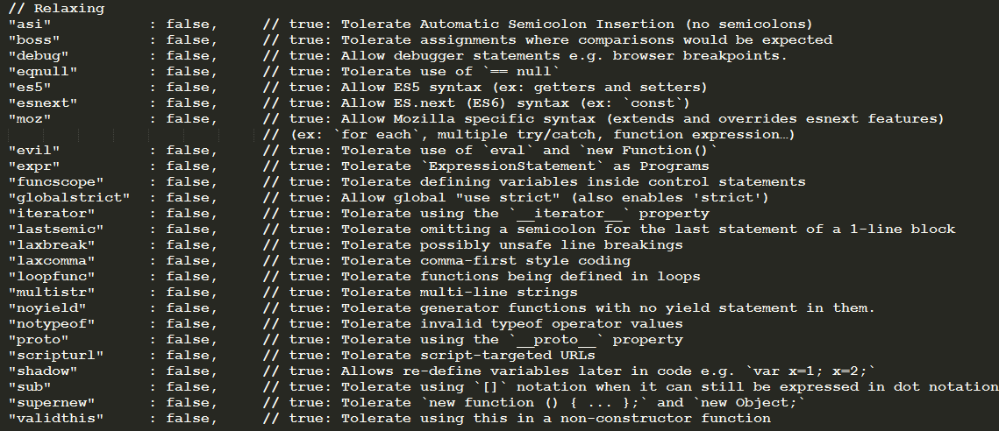
JSHint Options (contd) -- Relaxing

Slide 14
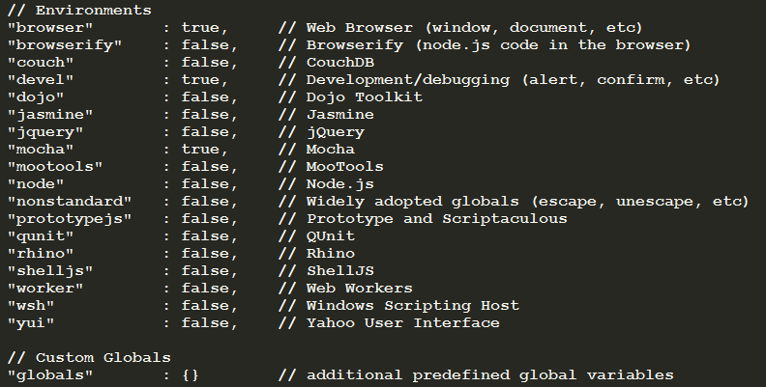
JSHint Options (contd) -- Environment

Slide 15
1
JSHint Overview
2
JSHint Usage
3
How to Integrate JSHint with Mave
4
How to Integrate JSHint with Jenkins
Q & A
5

Slide 16

Integrate JSHint with Maven
jshint-mojo is a recommended plugin for Maven.
Notes:
We prefer Maven as our project building tool in new architecture. So we’d better know how to integrate JSHint with Maven.

Slide 17
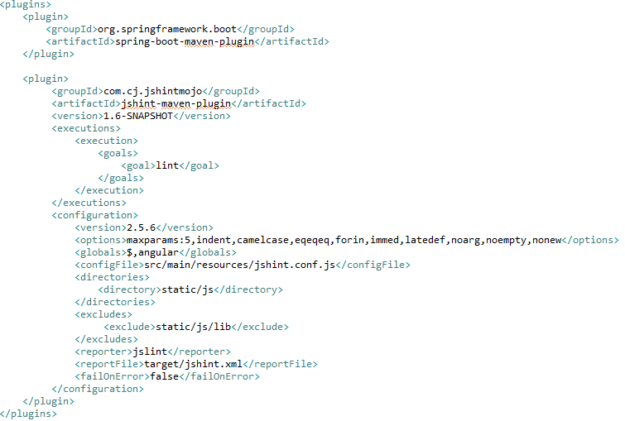
Integrate JSHint with Maven(contd)

Slide 18
1
JSHint Overview
2
JSHint Usage
3
How to Integrate JSHint with Mave
4
How to Integrate JSHint with Jenkins
Q & A
5
Notes:
This is a sample Agenda/Preview slide. This slide is ideal for setting the scene at the beginning of your presentation by providing a big picture overview of what you plan to cover.
To Change Titles in Shapes (i.e.: “Text here”):
Select text. (Optional: Press Delete.) Begin typing desired text.
To Change Font Color/Size:
Select text, right-click and adjust the font setting on the Mini toolbar. Select desired attributes to change: font, size, boldness, color, etc. Note: many of the same commands can also be accessed from the Font group of the Home tab.
To Change a Shape’s Fill Color:
Select the desired object by clicking once on its edge. On the Home tab, click the Shape Fill button within the Drawing group to select a theme color from the Symantec color palette.
To Delete a Shape:
Select the desired object by clicking once on its edge. Press the Delete key on your keyboard.
To Copy a Text Box or Shape:
Select the text box or shape. Note: Make sure to select the entire object, not just the text, by clicking the edge of the text box or shape.
Type Ctrl C (copy), click outside object, then type Ctrl V (paste) to place the object. Click and drag the pasted object to desired location.

Slide 19
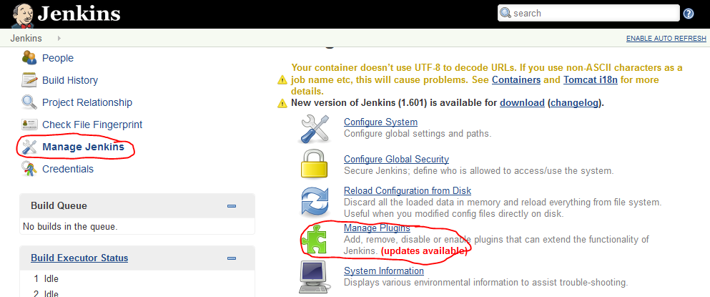
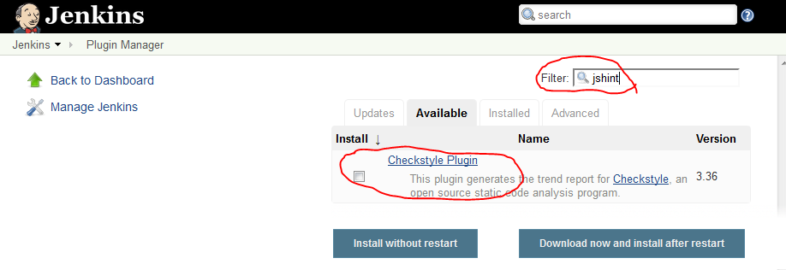
Integrate JSHint with Jenkins
‘Checkstyle Plugin’ is recommended tool.
Notes:
Currently, we are using Jenkins as our CI server. JSHint also provides a plugin to integrate with Jenkins.

Slide 20
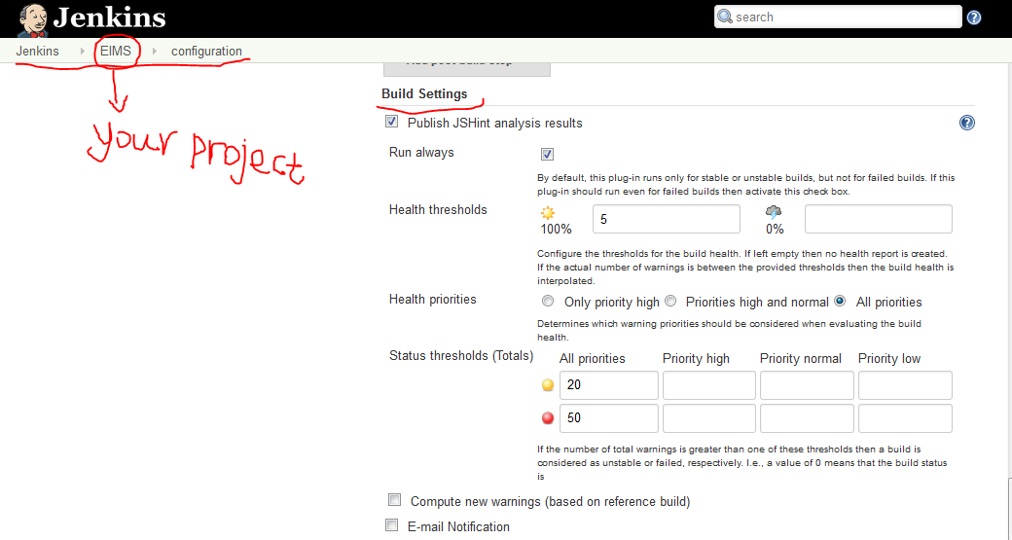
Integrate JSHint with Jenkins(contd)

Slide 21
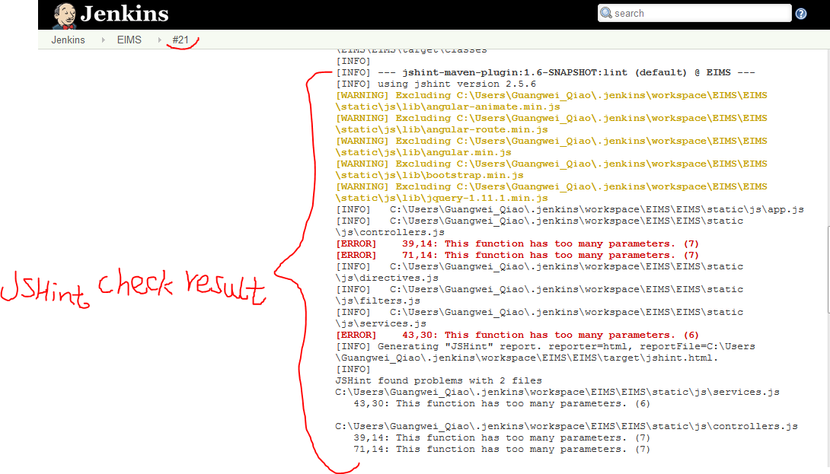
Integrate JSHint with Jenkins(contd)

Slide 22
Reference
JSHint source code https://github.com/jshint/jshint
JSHint Home: http://www.jshint.com/
JSHint Options: http://www.jshint.com/options/
JSHint Wiki in Symweb: https://symweb.rmnus.sen.symantec.com/BnR/Appliance/Engineering/DocumentsTechnologyTrack/JSHint.docx

Slide 23
Q & A

